Slide 1
Predictive Modeling
Logistic Regression
Decision Trees
Ensembles: Bagging and Boosting

Slide 2
Now that we know more about our data, let’s see how we can make predictions
Y
Task
Predict events/behaviours in the future
Example
When will machine break?
Output
Predicted time and uncertainty of prediction
Next steps
Use forecasts on ongoing basis to drive decision making
X
SOURCE: McKinsey Analytics Practice

Slide 3
Data partitioning is performed to find the “sweet spot” between over and under fitting a model
Underfitting
Sweet spot
Overfitting
Y
Y
Y
X
X
X
Poor generalisation as it fails to describe trends and relationships in the data
It is often a result of too simplistic models (e.g., not enough variables) or inadequate algorithms used (e.g., linear regression in non-linear data)
Good generalisation power, i.e., model will be able to infer conclusions with new data
Adequate amount of observations, variables and model complexity is required to select the best model – it is an iterative process to find the “sweet spot”
Poor generalisation, i.e., under perform when model sees new data
Happens normally due to high model complexity and inadequate training data (e.g., all the “noise” is being modelled)
SOURCE: McKinsey Analytics Practice

Slide 4
Data is typically split into training and test sets
Testing
Training
Dataset volume
Objectives
Raw data is split into 2 partitions, a training set and a testing set
The training set is used to develop a model, e.g., in a regression the model will use the target variable Y and the predictor variables X1, X2, X3 …, Xn to build a linear relationship in the form of Y = a + a1 X1 + a2 X2 … an Xn
The model developed is then applied in new predictor variables X1’, X2’, X3’ … Xn’ contained in the test set
As the model has never seen the X’n variables before, the performance on the test set, measured by the difference between Y’n in the test set and the predicted Y’n by the model is a good indication of how the model will perform with completely new data
Typical ratios are 90:10; 80:20; 70:30; for train:test split, dependent on the quantity of data available¹
Raw data
Partitioned data
1 As a rule of thumb the test set size should be ~1/$\sqrt{n}$ where n is the amount of adjustable variables in the dataset
SOURCE: AT&T bell labs, “A sealing law for the validation – set training – set ratio”

Slide 5



Difficulty of predictive techniques increases from classical single learners over advanced single learners to ensemble learning
Description
Best for
Challenges
Example application
Difficulty
Classical Single Learner
Predicts future event with a classical single technique, e.g., Linear/Logistic Regression, Decision Trees, Naïve Bayes
Getting quick transparent prediction with method that is easy to interpret
Quantifying effect of individual drivers on overall outcome
Results may have limited accuracy
Predict timing of maintenance needs for machinery based on performance data
Advanced Single Learner
Predicts future event with advanced single technique such as Neural Networks, Support Vector Machines, Elastic Net
Getting quick and defined single method
Quantifying effect of individual drivers on overall outcome
Results may have limited accuracy
Due to complexity, typically hard to interpret reason for predictions
Identify which process steps are best predictors of overall time taken for maintenance shutdowns
Ensemble Learning
Combines several learners to predict a future event with highest possible accuracy
Predicting a specific business event (e.g. churn) with highest possible accuracy
Improves predictions from single learners
Predictions come without a reason (“Black Box”)
Small data sets can quickly be overfitted
Predict competitive procurement pricing levels in a market with many external factors and “noise”
SOURCE: McKinsey Analytics Practice

Slide 6
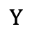
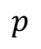
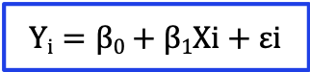
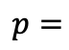
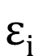

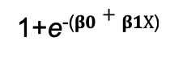
From Simple Linear Regression to Logistic Regression
$$Yi=β0+β1Xi+εi$$
$$Yi=β0+β1Xi+εi$$
Linear model
Y
$$Y$$
1
Observed value of Y for X_{i}
$$p$$
Logistic model
$$εi$$
Slope = β₁
1
$$p=$$
Predicted Value of Y for X_{i}
1+e⁻⁽$β0+β1X$⁾
Random Error for this X_{i} value
0
Intercept = β₀
X_{i}
X
X_{i}
X

Slide 7
Logistic regression is a simple model for binary dependent variables
What is it?
When dependent variable is binary – label falls in one of two categories
Logistic regression models the probability that Y belongs to a particular category
E.g., if predicting default:
might predict default if model gives a predicted probability >0.5
However we saw previously that this threshold can change
Why use it?
Output is transparent, easy to interpret and easy to implement which helps to get buy-in
Easy compliance with government regulations
?
When to use it?
When you have a clear hypothesis about what to solve
Data needs to be structured
Regulation requirement of clear model description
SOURCE: McKinsey Analytics Practice

Slide 8
Decision trees
What is it?
A systematic approach to segment the space of your predictors into a number of simple regions:
we use if-then statements to define patterns in data
We understand average behavior/response of each region (using mean or mode)
Then we classify the region with a single dependent variable label
We will then have a tree for predictions
?
Why use it?
Output is highly visual and easy to interpret
Neither linearity of relation nor independence of parameters is required
When to use it?
When you have a clear hypothesis about what to solve for
Prediction of segment-specific customer behavior (e.g., buying decisions, churn rate, consumption rate)
SOURCE: McKinsey Analytics Practice

Slide 9
Decision trees
Start from the root of tree
P(-) = 16/30 ≈ 0.53
P(+) = 14/30 ≈ 0.47
?
:14
Refund
:16
Yes
No
+
Marriage status
Yes
No
Married
Single, Divorced
?
-
TaxInc
:1
:13
<80K
?
>80K
:12
:4
-
+
P(-) = 12/13 ≈ 0.92
P(+) = 1/13 ≈ 0.08
P(-) = 4/17 ≈ 0.24
P(+) = 13/17 ≈ 0.76
Which variable decreases the “entropy”?
SOURCE: Data Science for Business by Foster Provost and Tom Fawcett, 2013. Page 54.

Slide 10
Basic principles of decision trees
The first statement is a fork – it splits the data into two branches based on some value of a particular variable
The value between the branches is called a cut point. Observations to the left of point get categorised one way, while those to the right in another way
At the best split, the results of each branch should be as pure as possible (cf. node impurity measures)
Algorithm repeats the process above on subsets of the observations – called recursion
Additional forks add new information (predictors) that can increase a tree's prediction accuracy
Final tree branch ends are leaf nodes or terminal nodes. Our decision tree models classify observations based on which dependent variable is majority (for classification problems) or the mean/mode (for regression problems)
SOURCE: McKinsey Analytics Practice

Slide 11
There are different techniques to decide on the “best split”
Regression problems
Residual sum of squares (RSS) – sum of squared error differences between the predicted values and actual values – to split at each node
Cost complexity pruning: Weakest link pruning based on tuning parameter α that controls trade-off between sub-tree’s complexity and fit to training data
Classification problems
Splitting techniques
Classification error rate – Fraction of training observations in a region that don’t belong to the most common class
Gini index – Measure of total variance among the K-classes
Cross entropy – Similar to Gini index numerically
Heuristic: Prefer attribute that produces the “purest” sub-node (least impurity) and leads to the smallest tree
Gini index/cross entropy preferred for splitting as more sensitive to node purity
Classification error rate preferred for pruning if prediction accuracy is final goal of pruned tree
SOURCE: McKinsey Analytics Practice

Slide 12


Decision trees typically outperform in non-linear situations and are highly interpretable
Strengths
Challenges
Can outperform classical approaches, if there are highly non-linear/complex relationships
Generally highly interpretable and easy to explain
Provide visualisations and graphical representation
Potentially more closely mirror human decision-making
Can handle quantitative predictors without need for dummy variables
Non-robust – small data change can cause large change in final tree
Top-down, greedy approach – recursive binary splitting (makes best split at each step without looking ahead) – can prevent ‘edge solutions’ from being picked up
Overfitting is a common problem and needs to be watched out for
SOURCE: McKinsey Analytics Practice

Slide 13
Improve model performance by combining multiple models into ensemble
Original Data
Subset 1
Subset 2
Subset 3
Ensemble of Models

Slide 14
Improve model performance by combining multiple models into ensemble
New data
A new data point (future data)
Like a new Titanic passenger
Combine a bunch of independent models together
Can be any type of algorithms
Prediction 1
Prediction 2
Prediction 3
Vote for classifiers
Average for regression
Vote
Prediction of the Ensemble

Slide 15
Bagging vs. Boosting
Single
Bagging
Boosting
…
…
1 iteration
Parallel
Sequential

Slide 16
Bagging vs. Boosting
Single
Bagging
Boosting
Train
Evaluate
Y
N
Keep?
Train
Train
Repeat i
Keep
Keep
Set weight for learner i
Update samples’ weights
Train & keep
Train & keep
Train & evaluate

Slide 17
Bagging explained
Original data
Sampling with replacement
Each bag contains variations of the original datasets
In turn this will result in different trees
Bag 1
Bag 2
Bag 3

Slide 18
Bagging explained
Original Data
Create a projection of the dataset sampled with replacement
Each bag is randomly different, producing different trees
Bag 1
Bag 2
Bag 3
Build a tree out of each bag
Combined Ensemble of Models

Slide 19

Bagging is good for you
Reduces variance in estimate
Prevents overfitting
Robust to outliers
Single learner
Ensemble

Slide 20
Random Forests are an ensemble model of multiple trees
Tree 1
Tree 2
Dataset
Dataset
Tree 3
Tree 4
Printed
Dataset
Dataset
Traverse each tree and at each node in a tree
Select m random predictor variables from available set
Use the variable with best split (use objective function)
Move to next node in tree
SOURCE: http://www.slideshare.net/eoinbrazil/introduction-to-machine-learning-using-r-dublin-r-user-group-oct-2013

Slide 21
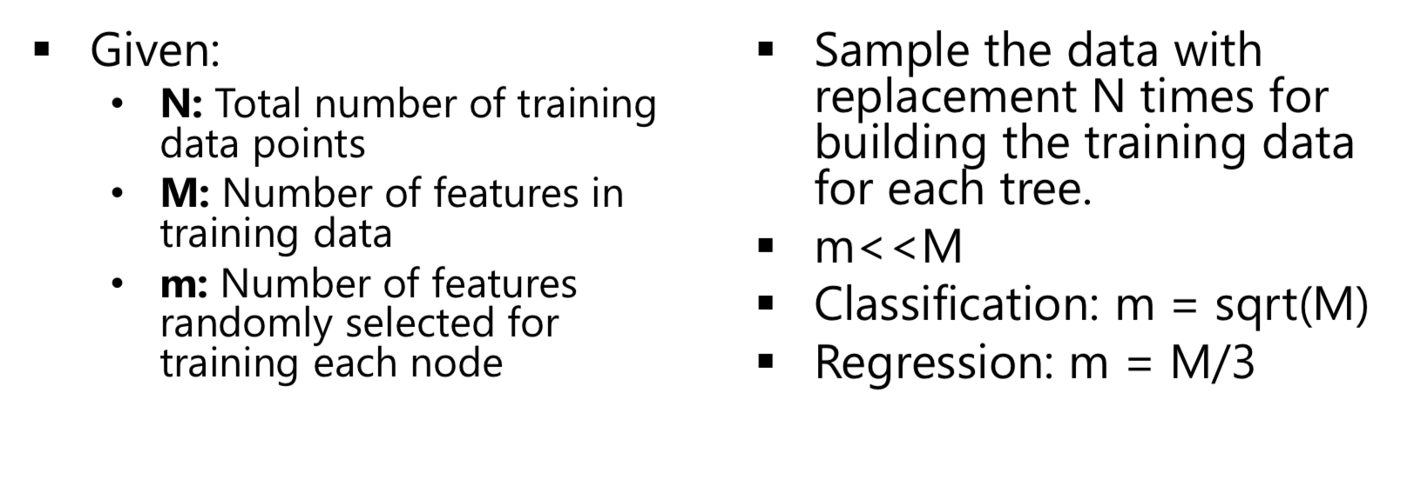
Rule of Thumb

Slide 22
Learning a forest
Dividing training examples into T subsets improves generalization
Reduces memory requirements & training time
Train each decision tree t on subset It
Same decision tree learning as before
Multi-core friendly (GPU implementation)

Slide 23
Booosting
An iterative procedure to adaptively change distribution of training data by focusing more on previously misclassified records
Initially, all N records are assigned equal weights
Unlike bagging, weights may change at the end of boosting round

Slide 24
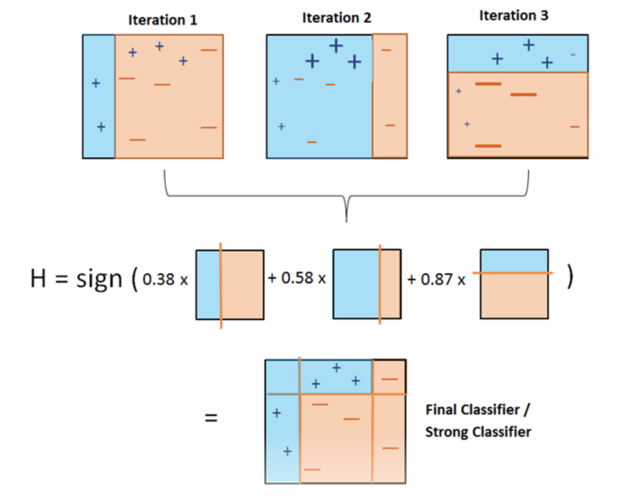
Boosting explained

Slide 25
Boosting Intuition
We adaptively weight each data case.
Data cases which are wrongly classified get high weight (the algorithm will focus on them).
Each boosting round learns a new (simple) classifier on the weighed dataset.
These classifiers are weighed to combine them into a single powerful classifier.
Classifiers that obtain low training error rate have high weight.
We stop by monitoring a hold out set.

Slide 26
There are dozens of us
AdaBoost (Adaptive Boosting)
Gradient Boosting
XGBoost (Extreme Gradient Boosting)
Catboost
Less popular
BrownBoost
LogitBoost

